Slide 1

Partners, Plans, and Prayers
Chapter 15:14 – 33
3 November 2021
Week 32

Slide 2

Romans 15:14 – 33
Overview . . .
At this point, Paul begins to draw this epistle to a close by making remarks concerning his apostleship and plans to see them. Recognizing their own abilities in the faith, he still felt it appropriate to write to them as he did (15:14-16).
Speaking of his design not to preach where Christ had already been received (15:17-21), Paul tells of his plan to come to Rome on his way to Spain (15:22-24).

Slide 3
Romans 15:14 – 33
Overview . . .
But first, Paul is going to the poor saints in Jerusalem with a contribution from the saints in Macedonia and Achaia (15:25-29).
Realizing the danger such a trip entails, he asks to be remembered in their prayers (15:30-33).

Slide 4

Tonight’s focus . . .
“Partners, Plans, and Prayers”

Slide 5
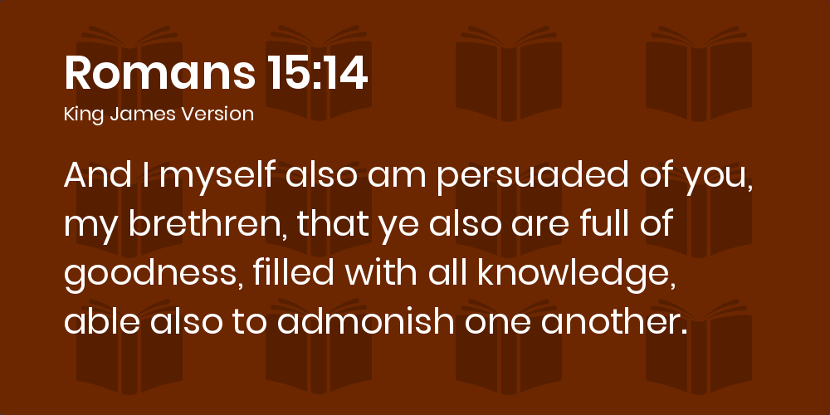
Romans 15:14

Slide 6
Romans 15:14
Paul affirms the saints in Rome using three phrases of commendation, each one pointing to a specific character trait he observed among the few members he had encountered or identified as a result of their reputation.
  1) “Full of goodness.”
  2) “Filled with all knowledge.”
  3) “Able to admonish.”

Slide 7
Romans 15:14
“FULL OF GOODNESS” The word “full” means filled to overflowing, and the word “goodness” describes moral ethical purity. It would include kindness and thoughtfulness and even charity toward those in need.
These are the same Romans who were earlier told that all are depraved. Believers remain depraved individuals in our old nature, but we receive a new nature with the regeneration and subsequent filling of the Holy Spirit. This new nature is evidenced by acts of kindness.

Slide 8
Romans 15:14
“FILLED WITH ALL KNOWLEDGE” They were filled to overflowing with such knowledge as to be completely informed and adequately aware. The believers in Rome demonstrated a mature command of Christian truth and understood the issues that impacted their corner of the world.
When believers are fully and completely informed, when they have become adequately aware, they understand their times and realize what they must do. They don’t typically lack zeal or vision.

Slide 9
Romans 15:14
“ABLE TO ADMONISH” The word “able” is related to the Greek term for “power.” They are empowered from within to apply their knowledge in a very constructive way. The word “admonish” is a compound of two words: “mind” and “to place.” The idea of placing something in the mind of another was how the Greeks understood the process of education.
The Roman Christians were able “to impart understanding,” “to set right,” “to lay on the heart” in such a way as to influence not merely the intellect, but the will and disposition.

Slide 10
Romans 15:14
These three qualities essentially describe a mature Christian. Imagine the impact churches would have on the world if they were composed of people who are morally clean and ethically pure, filled with such knowledge as to be completely informed and adequately aware, and able to educate one another and hold each other accountable.
Pastors devote their lives to seeing their churches transformed—one person at a time—to be full of goodness, filled with all knowledge, and able to admonish.

Slide 11
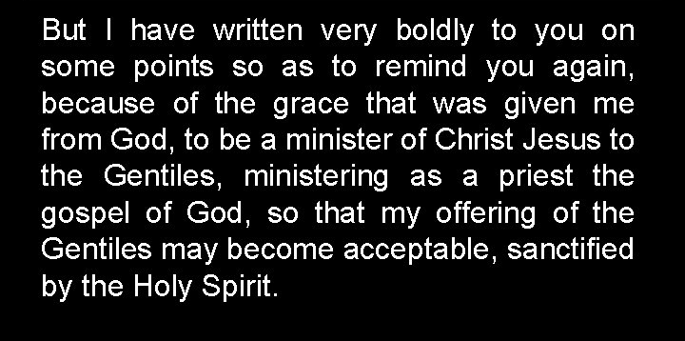
Romans 15:15 – 16

Slide 12
Romans 15:15 – 16
After Paul’s long discourse on the basic of the gospel, one might think the Roman believers were not mature in their faith or were in dire need of instruction.
So the apostle clarified that he didn’t write this bold Christian manifesto to provide new information but to help them retrace the steps own spiritual journey, to help them appreciate again the inestimable value of the grace they had received, to confirm them in the security of their salvation, and to prompt them to action.

Slide 13
Romans 15:15 – 16
Moreover, Paul saw this as his apostolic duty—his debt (Rom. 1:14)—to teach and strengthen all churches, including the one in Rome.
Paul was not merely justifying his letter by restating his duty as an apostle and reiterating his particular mission among the Gentiles.
Paul stated at the beginning that his intention was to visit the capital city in order to “obtain some fruit among you also, even as among the rest of the Gentile” (Rom. 1:13).

Slide 14
Romans 15:15 – 16
Paul hoped to join them in evangelizing Rome. Here at the end of the letter, however, he took these intentions a step further.
As he surveyed the potential for ministry in Rome, Paul saw even more lying beyond their western horizon.
Having identified the Roman believers as worthy partners, Paul then shared his vision and plan for the next phase of his journey.

Slide 15
Romans 15:17 – 21
¹⁷Therefore I glory in Christ Jesus in my service to God. ¹⁸I will not venture to speak of anything except what Christ has accomplished through me in leading the Gentiles to obey God by what I have said and done. ¹⁹by the power of signs and wonders, through the power of the Spirit of God. So from Jerusalem all the way around to Illyricum, I have fully proclaimed the gospel of Christ. ²⁰It has always been my ambition to preach the gospel where Christ was not known, so that I would not be building on someone else’s foundation. ²¹Rather, as it is written: “Those who were not told about him will see, and those who have not heard will understand.”

Slide 16
Romans 15:17 – 21
Here, we have a rare opportunity to learn something about the apostle Paul. Despite his impressive resume of qualifications and accomplishments, he thought of himself as merely a bond-slave of Jesus Christ.
He remained unwilling to take any credit for the deeds of his Master. The miracles he performed were genuine because the power of the Holy Spirit within him was real.
Gentiles had been won, and their obedience was seen in what they said and did because God chose to preach through him.

Slide 17
Romans 15:17 – 21
The gospel thrived in cosmopolitan cities because Paul had obeyed and persevered. No one could argue that his ministry was ineffective.
Note the word “fully” in 15:19. Paul declares that he had “fully preached the gospel” in the expanse between Jerusalem and Illyricum, which comprised most of the territory that Rome fully controlled.
In other words, Paul is saying, “My job in this part of the world is complete, and I leave it in very capable hands.”

Slide 18
Romans 15:17 – 21
Paul then quotes Isaiah 52:15 to underscore his primary motivation: to go where the gospel had not yet been heard.
Isaiah’s vision of the Messiah ruling over all the earth and Gentiles from every nation falling prostrate before Him became Paul’s mandate. His first three missionary journeys had barely begun to fulfill the prophet’s oracle.
Therefore, Paul’s vision always exceeded his horizon, compelling him to go wherever the gospel was unknown.

Slide 19
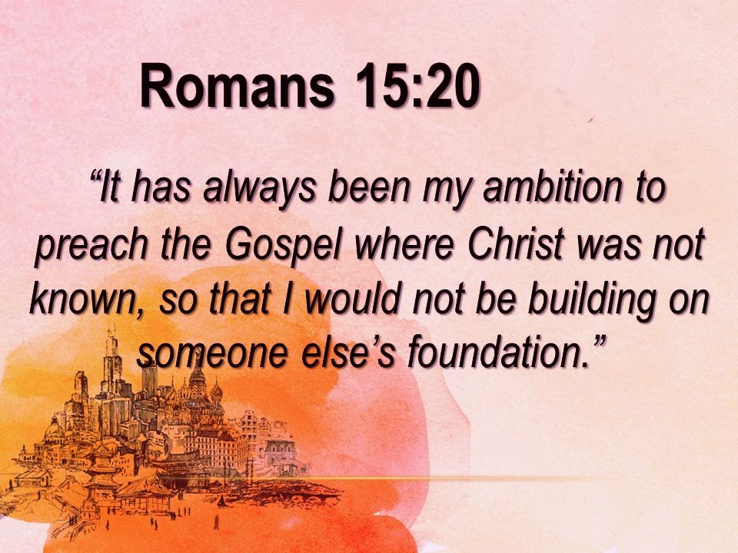

Slide 20
Romans 15:17 – 21
Swindoll > “This is what I love about Paul—his dreams were always greater than his memories.”
Memories can either anchor you to the past or thrust you toward new challenges. Paul’s memories of past success didn’t slow him down; on the contrary, they inspired him to achieve more for the sake of Christ.
Paul recalled the former success and abiding vision, not to boast or to garner admiration for himself, but to lay the foundation for his proposal.

Slide 21
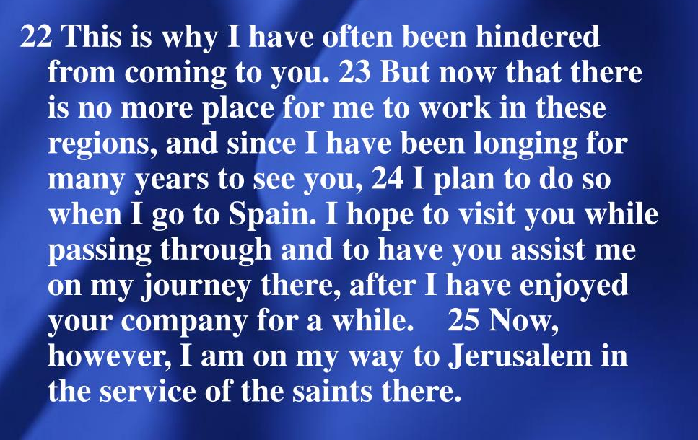
Romans 14:22 – 25

Slide 22
Romans 15:22 – 25
Paul states that this is why “I have been much hindered from coming to you” (15:22). Up to this time, Paul had always found new areas for ministry in Asia Minor and the Grecian Peninsula so that he had not yet felt free to look beyond to Rome and Spain.
Paul is saying, in effect, “My vision has always been to proclaim the gospel where it has never been heard; by the grace of God, this ministry has been successful; and I have done all I can to the east of Rome, so now . . .”

Slide 23
Romans 15:22 – 25
Paul quickly turns his perspective from the past to the future. In the past, his ministry kept him occupied with necessary work in the east, “but now” new plans lay to the west, in Rome and far beyond.
Having affirmed the church in Rome as a valuable partner and having presented himself as someone trustworthy to represent them in ministry, Paul graciously suggests a joint venture.
He plans to complete his current mission, deliver the famine-relief collection to the church in Jerusalem, and then set out for Spain.

Slide 24
Romans 15:22 – 25
Paul’s typical strategy for evangelizing a region began by establishing a base of operations in a large city along major trade routes.
Using Rome as a launching point, Paul planned one of two potential missions. He could have boarded a ship in Rome and sailed directly for the region we now call Spain.
This territory had been conquered by Rome but was much like the American West in 1840—filled with potential yet largely untamed.

Slide 25
Romans 15:22 – 25
Paul didn’t dream on a small scale! The landmass he planned to evangelize exceeded the territory covered by his first three missionary journeys.
And the extent of the hardship on those journeys alone was a good comparison as to what might lie ahead of him on this fourth journey as stated in 2Cor. 11:24-28 . . .

Slide 26
Romans 15:22 – 25
“Five times I have received from the Jews the forty lashes minus one. ²⁵Three times I was beaten with rods. Once I received a stoning. Three times I was shipwrecked; for a night and a day I was adrift at sea; ²⁶on frequent journeys, in danger from rivers, danger from bandits, danger from my own people, danger from Gentiles, danger in the city, danger in the wilderness, danger at sea, danger from false brothers and sisters; ²⁷in toil and hardship, through many a sleepless night, hungry and thirsty, often without food, cold and naked. ²⁸And, besides other things, I am under daily pressure because of my anxiety for all the churches” (2Cor. 11:24-28).

Slide 27
Romans 15:22 – 25
Think of it! This was Paul’s experience in the “civilized” part of the empire.
His plans would take him to the fringes of the Pax Romana (the “peace of Rome”) and beyond, where he would be at the mercy of “barbarians”—people who answered to no one.

Slide 28
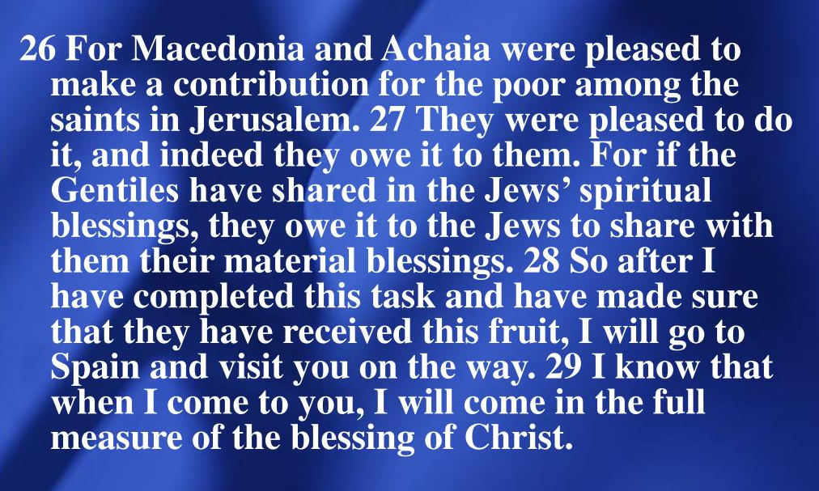
Romans 15:26 – 29

Slide 29
Romans 15:26 – 29
Paul uses the generous example of the churches in Macedonia and Achaia—present-day Greece—to inspire the church in Rome. The Gentile believers in Greece viewed their sharing of material wealth as a mere token of the debt they owed Jerusalem for the gift of the gospel, an immeasurable spiritual treasure.
Clearly, Paul implies that Rome also owed a debt of gratitude, which could be honored by helping his mission to rescue other Gentiles.

Slide 30
Romans 15:26 – 29
Paul was certain of his visit to Rome; however, he could not have imagined the circumstances that would take him there. After delivering the famine-relief funds he had collected, the apostle was falsely accused by Jewish leader in the temple—the very men he formerly served when persecuting Christians—and arrested.
After several hearings, a foiled assassination plot, month in protective custody, and a lengthy trial, Paul exercised his right as a Roman citizen to have his case heard in Rome (Acts 21-22). So, Paul did reach his intended destination: Rome.

Slide 31
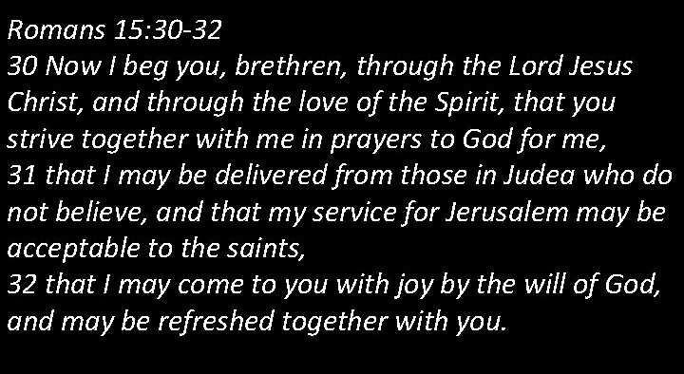
Romans 15:30 – 32

Slide 32
Romans 15:30 – 32
Paul pleads with the church in Rome to begin their partnership with him by praying. Here he entreated the Romans by our Lord Jesus Christ and by the love of the Spirit to join him in his struggle through “intercessory prayer.”
Furthermore, Paul urges his brothers and sisters to “strive together” with him, as members of a team might strenuously compete together to achiever a victory.

Slide 33
Romans 15:30 – 32
Paul was not overstating his desire for their earnest prayer. While he felt duty-bound to deliver the famine-relief funds to Jerusalem, he had serious misgivings about his safety upon returning there.
Later, during his voyage from Corinth to Jerusalem, he called the church leaders in Ephesus to meet him before his ship put back to sea.

Slide 34
Romans 15:30 – 32
There dockside, Paul states flatly,
  “And now, behold, I am going to Jerusalem, bound in the Spirit, not knowing what shall befall me there; ²³except that the Holy Spirit testifies to me in every city that imprisonment and afflictions await me. ²⁴But I do not account my life of any value nor as precious to myself, if only I may accomplish my course and the ministry which I received from the Lord Jesus, to testify to the gospel of the grace of God” (Acts 20:22-24).

Slide 35
Romans 15:30 – 32
This very real danger prompted Paul to ask for three specific answers to prayer:
FIRST – he prayed his enemies would be unsuccessful in their attempts to keep him from continuing his ministry.
SECOND – he prayed the Jewish Christians in Jerusalem would accept the monetary gifts offered by their Gentile family in Greece.
THIRD – he prayed his plans for continued ministry beyond Rome would not only escape delays but also find help in the Roman church.

Slide 36
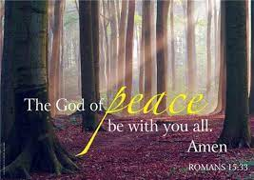
Romans 15:33

Slide 37
Romans 15:33
Paul was undoubtedly the most pioneering of all the apostles. The biblical record shows that he logged more miles, planted more churches, trained more leaders, and wrote more Scripture than any other person in his generation.
Nevertheless, we rarely if ever find him alone. He surrounded himself with gifted, driven people who shared his obligation to preach the gospel and to strengthen churches.
He sought partners he could wholeheartedly trust, those who would not settle for anything less than complete devotion.

Slide 38
Romans 15:33
And when Paul found trustworthy co-laborers, he was quick to place them where they would have the greatest impact.
Although seasoned by struggle and hardship, although undeterred by danger, Paul knew his vision to blaze new trails through the Roman frontier could only be realized with the help of dependable partners.
We con only speculate as to how his plans might have unfolded. The book of Acts ends with Paul under house arrest in Rome.

Slide 39
Romans 15:33
SWINDOLL > “I personally believe he realized at least part of his vision before a second imprisonment in Rome and eventual martyrdom there.”
If Paul’s dreams did carry him westward toward Spain, I have no doubt the help of his Roman brothers and sisters filled his sails.

Slide 40

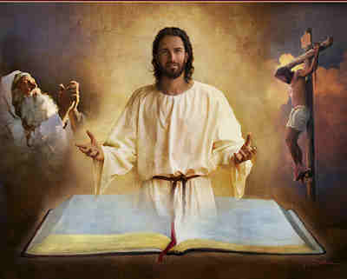
Partners . . . co-laborers with Christ

Slide 41
NEXT CLASS – 10November 2021
Book of Romans
Before next class, read the below chapter in the KJV and in one other versions of the Bible, i.e., NKJV, NRSV, NIV, CEV, etc . . .
Read Chapter 16:1 – 27
1st lesson: v1 – 16 “Love and a Holy Kiss
2nd lesson: v17 – 27 “Trouble Makers and Blessed Saints within the Vineyard”

